Slide 1
Question of the Day
Using the Glossary complete the following:
Define Learning Perspective
Define Classical Conditioning
How are these two terms related?

Slide 2
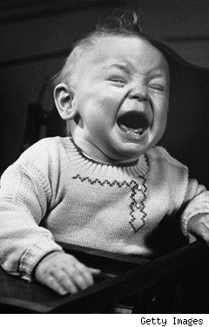
Classical Conditioning

Slide 3
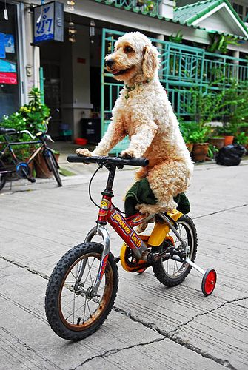
The Basics
Learning-
Learning can be defined as a permanent change in behavior that results from experience

Slide 4
Pavlov’s Experiment
Unconditioned Stimulus (US)- an event that leads to a certain predictable response without training or automatic not learned (food)
Unconditioned Response (UR)- a reaction that occurs naturally and automatically (salivation)
Conditioned Stimulus (CR)- an ordinarily neutral event, after training leads to a response (sound of bell leads to salivation)
Neutral Stimulus (NS)- has nothing to do with the response (bell)
Conditioned Response (CR)- a learned behavior (salivation)
Classical Conditioning- controlling a response in a way that the old response becomes attached to a new stimulus

Slide 5
Bear Cub Example
Unconditioned Stimulus (US): Dangerous Animal
Unconditioned Response (UR): Runs away (Bear cub did so naturally)
Neutral Stimulus (NS): A particular Scent- before experiment bear cub might not have had a reaction because it had nothing to do with food
Conditioned Response (CR) Runs away in response to the Scent (before scent was neutral or did not mean anything)
Conditioned Stimulus (CS): A bear cub may learn to associate a particular scent with appearance of a dangerous animal

Slide 6
Pavlov Dog Experiment
Fact: Dogs would salivate if meat was placed on their tongues because saliva aids in the eating and digestion of meat (meat on the tongue is a stimulus for the production of saliva)
Observed: dogs did not always wait until they received meat to start salivating (would start salivated in response to the clinking of food trays)
Why?: dogs learned from experience that these events clinking of trays meant the arrival of assistants or food was coming

Slide 7
Pavlov Dog Experiment connected to key terms
Unconditioned Stimulus (US): Meat
Unconditioned Response (UR): Salivation response to the meat (dogs did so naturally)
Neutral Stimulus (NS): the bell- before experiment dogs might have made dogs ears perk up not have made dogs salivate because it had nothing to do with food
Conditioned Response (CR): Salivation in response to the bell was a conditioned response (before bell was neutral or did not mean anything)
Conditioned Stimulus (CS): The bell leads to a Response of salivation
Summary: CR & CS are often same response or very similary

Slide 8
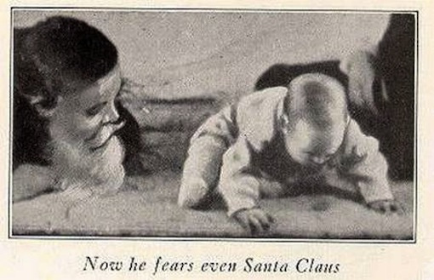
Conditioning
The acquisition of a classically conditioned response occurs gradually with each pairing of the conditioned stimulus and the unconditioned stimulus the learned response of CR is strengthened

Slide 9
Generalization & Discrimination
Generalization occurs when an animal responds to a second stimulus similar to the original
Pavlov 1st conditioned a dog to salivate when it was shown a circle (CS) then given meat (US)
After several pairings the dog salivated when presented with only the circle
Pavlov demonstrated that the dog would also salivate in response to the sight of many geometric figures

Slide 10
Generalization & Discrimination
Discrimination is the ability to respond differently to different stimuli that are not similar to each other
Dog’s weaker response to figures that looked less like a circle
Bear Cub would be able to tell the difference between a wolf and a mouse
Child that is afraid of dogs that growl will still be able to play with stuff animals even ones that looks like a dog

Slide 11
Classical Conditioning
Basic example: I liked my aunt; she always made me feel warm and wanted. She always wore a particular perfume. When I smell the perfume now, I immediately feel warm and wanted

Slide 12
Notes From Text Book
Turn to page 132 and copy the Key Concepts in Classical Conditioning Chart
Put chart in Evernote or a Microsoft Word Document

Slide 13
End of section 1 Questions
Describe Pavlov’s class experiment with dogs using the following terms: unconditioned stimulus, unconditioned response, conditioned response, conditioned stimulus.
People acquire certain behavior patterns through classical conditioning. Explain how this might happen. Give an example to support your explanation
How are everyday learning and physical behavior a result of classical conditioning?
How is classical conditioning part of our daily life?

